Slide 1
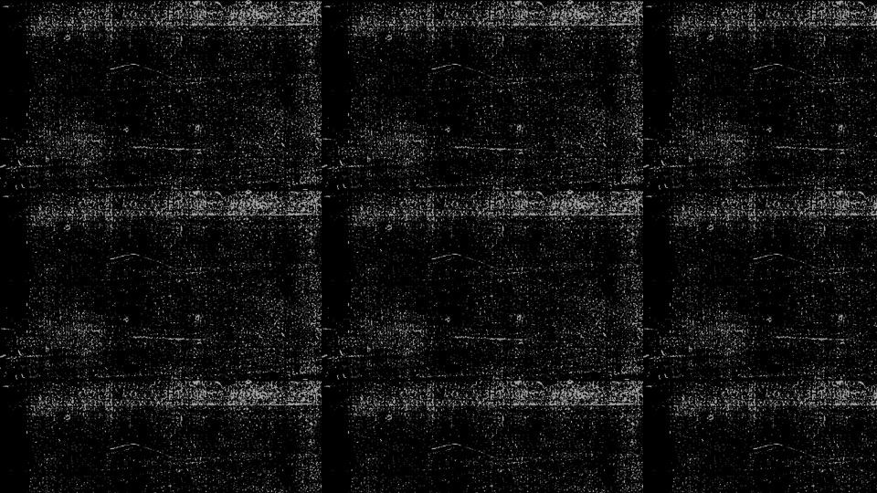
Generative Adversarial Networks(GANs)
&
Training Dynamics
By
Manika Singh
Sabha Ambrin
Seema Verma
Gaurav Singh Parihar

Slide 2
Introduction to Generative Models
Definition
Generative models learn the joint probability distribution P(x,z)P(x, z)P(x,z) and aim to generate new data samples similar to the training data.
Types of Generative Models:
Explicit density models: e.g., VAEs (learn probability distribution)
Implicit density models: e.g., GANs (no explicit probability, direct sample generation)
Applications:
Image and video synthesis
Text and music generation
Data augmentation
Anomaly detection
Drug discovery & medical imaging
2

Slide 3
VAE Theory + Loss Functions
VAE (Variational Autoencoder):
Combines autoencoder with probabilistic modeling
Encodes input into a latent space z with a Gaussian prior
Decoder reconstructs data from z
Key Components:
Encoder: q(z∣x)
Decoder: p(x∣z)
Loss Function (ELBO):
L=E q(z∣x) ​ [logp(x∣z)]−D KL ​ (q(z∣x)∥p(z))
Reconstruction loss: Measures how well the output matches input
KL divergence: Regularizes latent space to be close to prior
3

Slide 4
GAN Theory + Loss Functions
GAN (Generative Adversarial Network):
Introduced by Goodfellow in 2014
Two neural networks: Generator GGG and Discriminator DDD
Training Objective:
Discriminator: maximize log⁡D(x)+log⁡(1−D(G(z)))
Generator: minimize log⁡(1−D(G(z)))
Variants:
Wasserstein GAN (WGAN) with gradient penalty
Least Squares GAN
GANs are non-probabilistic, and training is a min-max game
4

Slide 5
Challenges in VAEs and GANs
VAEs:
Blurry outputs due to Gaussian assumptions
KL vanishing problem
GANs:
Mode collapse: Generator produces limited variety
Training instability: Non-convergence, oscillation
Sensitive to hyperparameters
No clear evaluation metric
Common Issue: Balancing quality and diversity of generated outputs
5

Slide 6
Output Samples from VAE & GAN
Visual Examples:
VAEs:
Show examples of smooth interpolations in the latent space (e.g., morphing between two faces).
Highlight the characteristic "blurriness" or lack of fine detail compared to GAN outputs.
GANs:
Show highly realistic and diverse images (e.g., faces, landscapes, synthetic objects).
Emphasize the sharpness and high fidelity of generated samples.
Briefly compare the visual characteristics of VAE vs. GAN outputs, highlighting their respective strengths and weaknesses in generation quality.
Presentation title
6

Slide 7
Techniques to Improve Generative Models
VAE Improvements:
β-VAE: Encourages disentangled representations
Conditional VAE (CVAE): Controls generation using labels
VQ-VAE: Discrete latent spaces with vector quantization
GAN Improvements:
DCGAN: Convolutional GANs with better structure
StyleGAN2: High-quality face generation with style control
CycleGAN: Unpaired image translation
Common Enhancements:
Progressive growing
Attention mechanisms
Self-supervision
7

Slide 8
Training Tips & Stability Techniques
General Tips (Applicable to Both):
Data Preprocessing: Crucial for success (normalization, scaling, augmentation).
Careful Initialization: Use appropriate weight initialization schemes (e.g., Kaiming, Xavier).
Optimizer Choice: Adam is a common and effective choice.
Batch Size: Experiment with batch sizes; it can significantly impact stability and performance.
GAN-Specific Stability Techniques:
One-sided Label Smoothing: Discriminator learns to predict slightly less than 1 for real and slightly more than 0 for fake.
Batch Normalization: Stabilizes training, especially in deeper GAN architectures.
Gradient Penalty (WGAN-GP): Penalizes the norm of the discriminator's gradient to enforce the Lipschitz constraint, improving WGAN stability.
Spectral Normalization: Stabilizes the discriminator's training by constraining its Lipschitz constant.
8

Slide 9
Hands-on Implementation Overview
Frameworks: PyTorch / TensorFlow
Dataset: MNIST / CIFAR-10 / CelebA
VAE Steps:
Build encoder and decoder networks
Reparameterization trick for backpropagation
Implement custom loss (reconstruction + KL)
GAN Steps:
Design generator & discriminator
Alternate training: 1 D step per G step
Monitor losses and sample outputs
Code Demos (if live): Show latent interpolation or generated faces
9

Slide 10
Key Learnings & Insights
Understanding GMs:
VAEs are better for structured latent representations
GANs excel in visual fidelity
Implementation lessons:
Importance of tuning
Debugging loss behavior is crucial
Comparative Insight:
VAEs are easier to train but less sharp
GANs need care but produce realistic outputs
Presentation title
10

Slide 11
Regularization & Stability in Generative Models
From Unstable Training to High-Quality Generation
The Challenge: Why Generative Models Fail
1. Mode Collapse (in GANs): Generator finds a few 'easy' outputs that fool the Discriminator and stops exploring the full data distribution.
Result: Low-diversity, repetitive samples.
2. Unstable Gradients: Balance between Generator and Discriminator breaks. Gradients vanish or explode.
Result: Training stalls or diverges completely.
The Toolkit: Key Stabilization Techniques
General Regularization:
• Batch Normalization: Normalizes layer inputs. Benefit: Faster & smoother training.
• Dropout: Deactivates neurons. Benefit: Prevents overfitting.
GAN-Specific Stabilization:
• Label Smoothing: Uses soft labels. Benefit: Better gradients.
• Gradient Penalty (WGAN-GP): Adds loss term. Benefit: Prevents gradient explosion.
11

Slide 12
From Theory to Results: A Visual Comparison
GAN Training Stability
Before: Unstable GAN Losses
Erratic, spiking losses show training collapse.
After: Stable GAN (WGAN-GP) Losses
Smooth, converging losses thanks to Gradient Penalty.
GAN Sample Quality & Diversity
Before: Mode Collapse
Generates only T-shirts/tops.
After: Diverse Samples
Generates trousers, coats, shoes, bags.
Key Takeaway: Regularization and stabilization techniques are essential for training modern generative models. They turn unstable training into a reliable process, leading to higher sample quality and diversity.
11

Slide 13
Conclusion
In conclusion we explored the capabilities of VAEs and GANs in generative modeling. We learned how VAEs generate data using latent space representations, while GANs produce high-quality samples through adversarial learning. Our implementation and analysis demonstrated the potential of these models to learn data distributions and create realistic synthetic outputs.
The results underscored the utility of generative models in tasks requiring synthetic data generation, representation learning, and creative applications. However, the models also revealed certain limitations, such as the tendency of GANs to exhibit training instability and the relatively lower image fidelity in VAEs compared to GANs. These insights provide motivation to further optimize model performance and explore hybrid architectures.
Presentation title
11

Slide 14
Future scope
Generative models continue to evolve with advancements like Diffusion Models and Generative Transformers. Future work may include exploring hybrid models such as VAE-GANs, improving training stability, and applying these models to real-world domains like medical imaging, video generation, and virtual environments. Responsible development with ethical safeguards will be essential as the technology matures.
Looking forward, generative modeling is poised to play an increasingly pivotal role across domains such as healthcare, autonomous systems, gaming, and scientific simulation. Future work could involve integrating attention mechanisms, exploring conditional and hybrid generative architectures (such as VAE-GANs), and applying these models to more complex and high-resolution datasets. Additionally, as generative models become more prevalent, it will be critical to examine their ethical implications and ensure that these technologies are developed responsibly. Continued research in this area holds immense promise for driving innovation across artificial intelligence and beyond.
Presentation title
12

Slide 15
THANK
YOU

